Slide 1
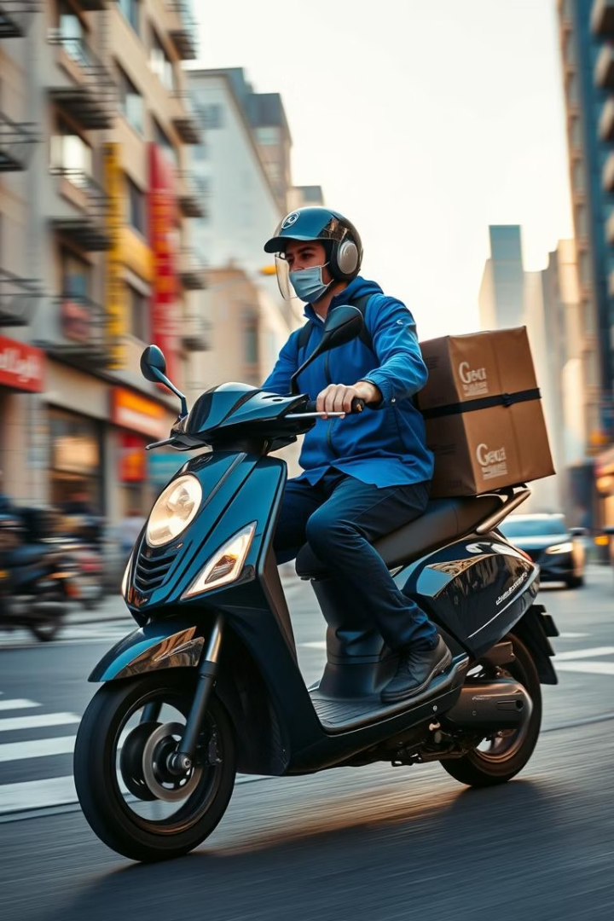
Predicting Food Delivery Times
This project aims to predict food delivery times. We analyze factors like distance, weather, traffic, time of day, and courier experience. Our goal is to enhance planning and customer satisfaction through faster, more reliable deliveries.
PRESENTED BY AYESHA IMRAN (2023-BSAI-011)

Slide 2
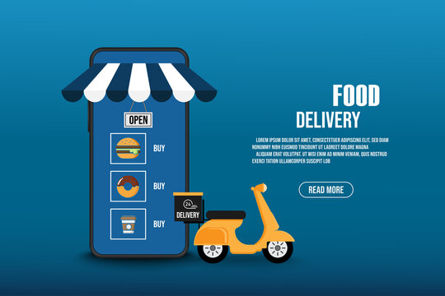
Dataset Overview
1000 Delivery Records
Distance traveled
Weather conditions
Traffic severity
Vehicle type
Key Data Points
Food preparation time
Courier experience
Actual delivery time (target)

Slide 3






Data Preprocessing Steps
Handle Missing Values
Fill in empty data points
Remove Duplicates
Eliminate redundant records
Identify Outliers
Remove anomalous data points
One-Hot Encoding
Convert categorical to numerical
Feature Scaling
Standardize numerical ranges

Slide 4

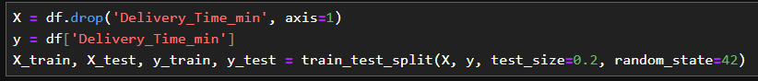
Modeling Approach
Linear Regression
Smart calculator predicts delivery time
Data Splitting
Training and testing subsets

Slide 5
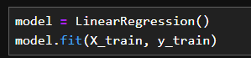
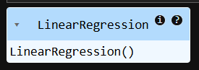
Modeling Approach
Model Training
Learn from historical data

Slide 6
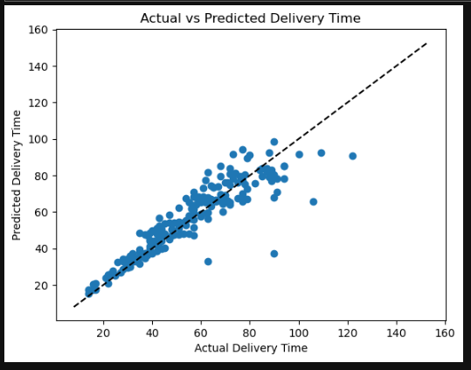



Model Evaluation
Actual vs. Predicted Plot
Visualizing model accuracy
Coefficients & Intercept
Understanding factor influence
Side-by-Side Comparison
Reviewing prediction closeness

Slide 7

Key Project Findings
Major Influencers
Secondary Factors
Predictive Power
Distance, weather
Courier experience
Forecast future deliveries
Traffic, prep time
Vehicle type
Reduce delays

Slide 8
Project Impact
Route Planning
1
Optimize delivery paths
Courier Assignment
2
Match skills to delivery needs
Customer Information
3
Provide accurate ETAs

Slide 9
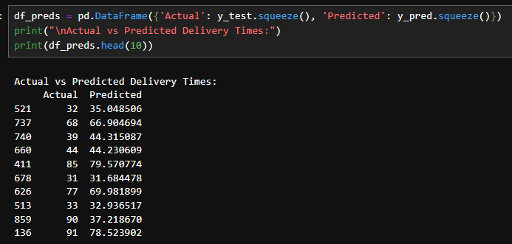
ACTUAL AND PREDICTED DELIVERY TIMES

Slide 10





Conclusion
Customer Satisfaction
1
Faster, more reliable deliveries
Improved Planning
2
Utilizing insights for efficiency
Factor Analysis
3
Understanding delivery drivers
Data Preprocessing
4
Crucial for model success
Regression Model
5
Effective time prediction

